Slide 1
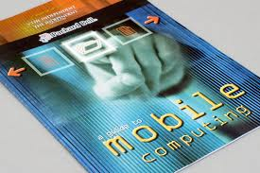
Mobile Computing

Slide 2
Mobile computing has three aspects:
1) Mobile communication
2) Mobile hardware
3) Mobile software

Slide 3
Definition
Mobile computing is "taking a computer and all necessary files and software out into the field

Slide 4
Many types of mobile computers
Wearable computer
Personal digital assistant/enterprise digital assistant
Smartphone
Carputer
Ultra-Mobile PC
Tablet computer

Slide 5
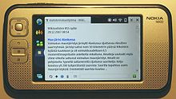
Portable computing devices
A portable computer is a general-purpose computer that can be easily moved from place to place, but cannot be used while in transit, usually because it requires some "setting-up" and an AC power source.
A Nokia N800 Internet tablet

Slide 6
Smart phone
A smart phone is a PDA with an integrated cellphone functionality. Current smartphones have a wide range of features and installable applications

Slide 7
Carputer
A carputer is a computing device installed in an automobile. It operates as a wireless computer, sound system, GPS, and DVD player. It also contains word processing software and is bluetooth compatible

Slide 8
Technical limitations of mobile computing
Insufficient bandwidth
Security standards
Power consumption
Transmission interferences
Potential health hazards
Human interface with device

